Slide 1
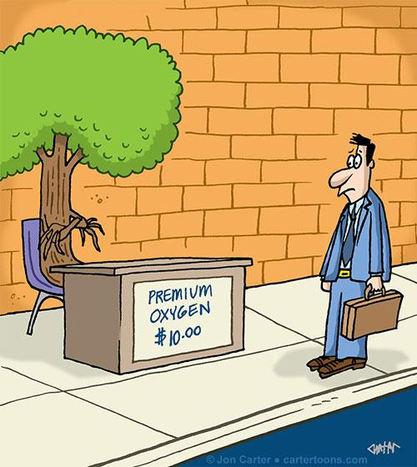
California Air Pollution & Impact
By: Amy, Stefani & Steven

Slide 2
Presentation Outline
Framing questions
Data sources
Data cleaning process
Results & visualizations
Pollution v. population characteristics
Geographic analysis
Major emission sources
Possibilities for effective interventions

Slide 3
Framing Questions
Is there a relationship between population characteristics and air pollution?
How does air pollution vary geographically?
What are the worst sources of air pollution?

Slide 4
Data Sources
CalEnviroScreen 3.0
A project to map California regions with high pollution levels
Operated by the California Environmental Protection Agency
We were primarily interested in:
Population
Poverty
Health effects
**Connected population with emissions
CALARB SET
Standard Emissions Tool- California Air Resources Board
Gives emissions projections by summary category, including:
Farming & agriculture
Petroleum refining
Transportation
** Insight into pollution sources

Slide 5
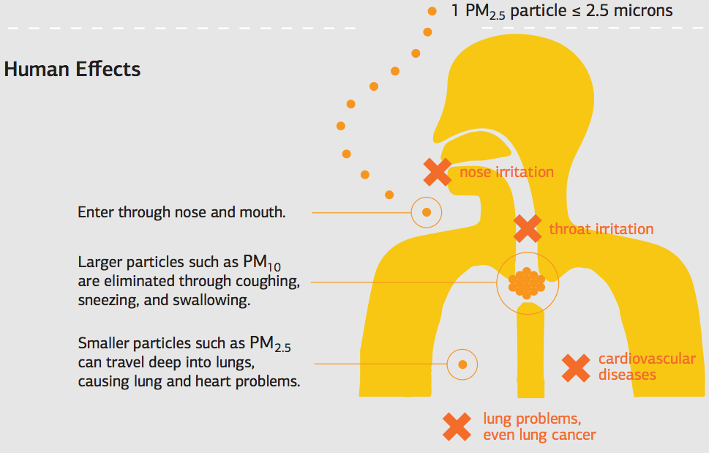
Pollutant: PM 2.5 particulate matter
Small particles can travel deep into the alveoli of the lungs
Possible Health effects:
Abnormal heart rhythms
Aggravated asthma
Persistent cough or difficulty breathing
Possible sources:
Mostly combustion sources, like traffic or power plants
Sulfate, nitrates, black carbon, mineral dust, etc
http://www.environment-assured.com/pm25/

Slide 6
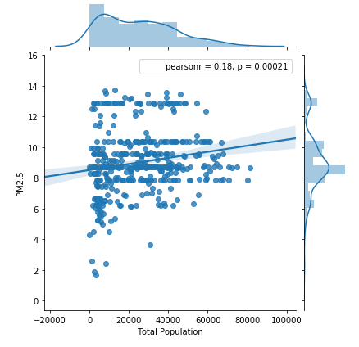
Population vs. PM 2.5
We were interested to see whether there was a trend between total population in zip code versus the PM 2.5 concentration,
Though PM 2.5 concentration does tend to increase with population, there isn’t a clear linear relationship between the two (each dot represents a zip code)

Slide 7
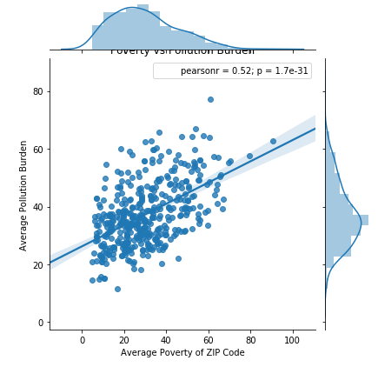
Poverty vs. Pollution Burden
There is an association between the average poverty of a zip code (% of people living at 2x federal poverty line or less) and their pollution burden score
More impoverished areas tended to suffer more pollution in aggregate

Slide 8
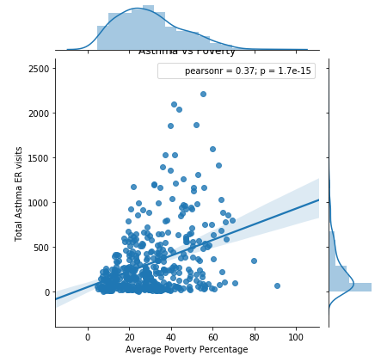
Poverty vs. Asthma ER Visits
While zip codes with lower poverty had lower numbers of asthma-related ER visits, greater poverty resulted in a greater range of asthma-related ER visits
Caveat: CalEnviro Screen did not have an adequate way to control for average community distance to ER
While not a direct link to PM 2.5, higher poverty with its higher pollution burden does appear to weakly correlate with ER visits

Slide 9
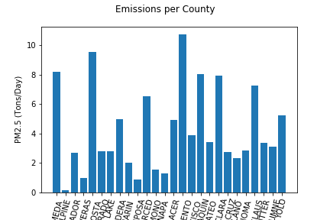
Emissions per County
Top Counties:
Sacramento
Contra Costa
Alameda
San Joaquin
Santa Clara
*Process: Grouped by County (including all facility categories), and got sum

Slide 10
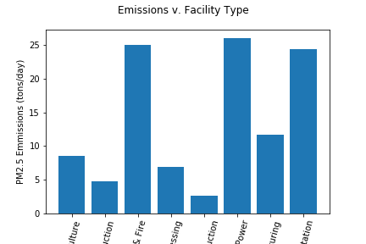
Emissions per Facility Type
Top Facilities:
Heating & power
Fire & dust
Tranportation
*Process: Grouped by County (including all pre-binned facility categories), and got sum

Slide 11
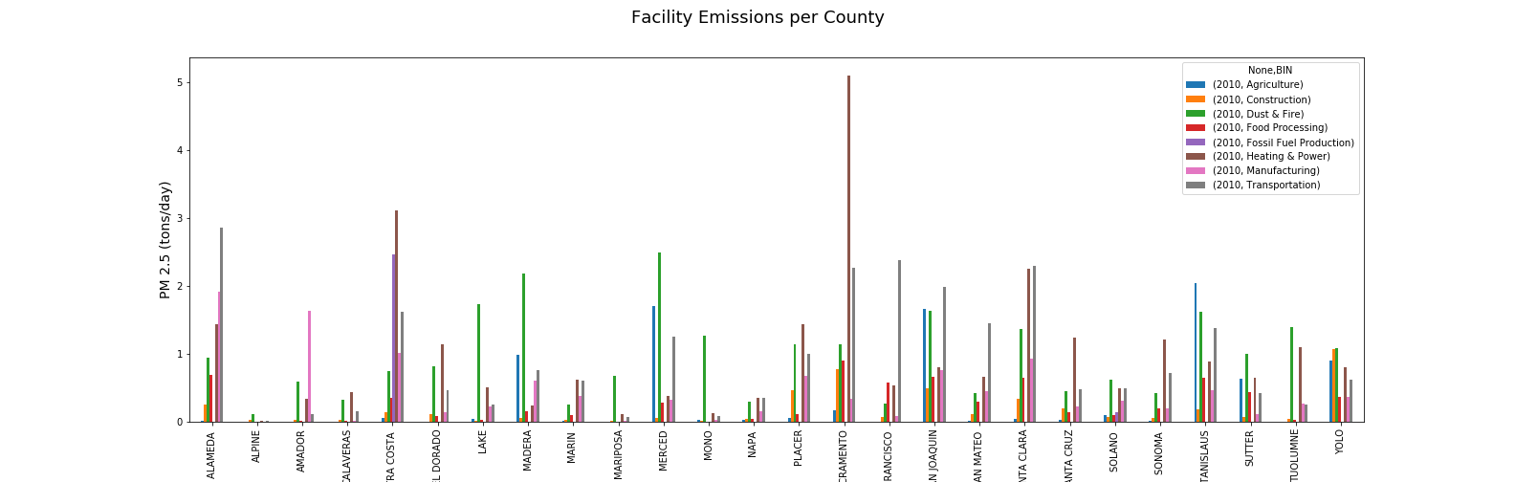
Emissions Breakdown (by Source) per County
Notes:
**Process: group by County, and then pre-binned facility type, and then plt.unpack

Slide 12
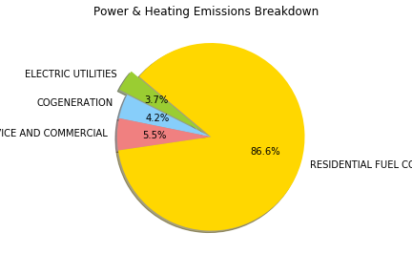
Snapshot: Power & Heating Emissions
Residential Fuel overall biggest contributor.
Also the most difficult to target for reducing emissions:
Most emissions come from woodfire heaters and stoves
People who are typically outside of public policy scope

Slide 13
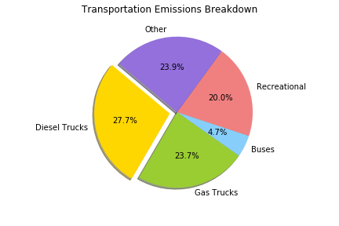
Traffic Emissions Snapshot
Trucking industry makes up over half of transportation emissions.
Recreational category includes: speed boats, off roading vehicles, etc.
While buses scored low in daily sum output, they scored as the highest for daily mean output.
Other included aircrafts, carrying ships, etc.

